Slide 1
F5+ MOUSE CLICK

Slide 2
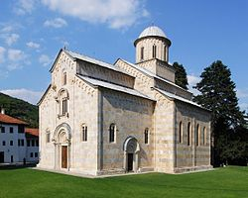
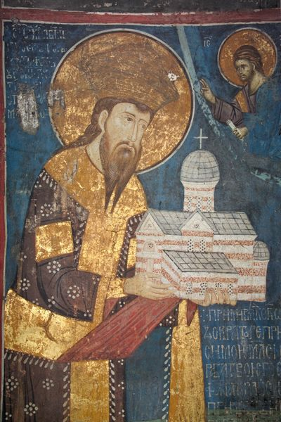
FOUNDER
… OF GOD
GUARDIAN
FALLEN
MICHAEL
GABRIEL
ANGEL
1
2
3
4
Visoki Dečani
monastery,
located near
Decani,
Kosovo and Metohija.
It was founded
in the first half
of the 14th century
by Serbian
king Stefan Decanski.
?
5
Notes:
2

Slide 3
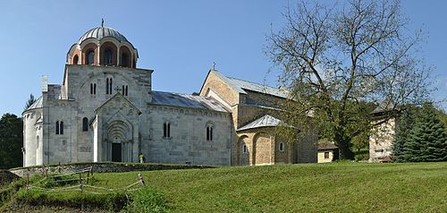
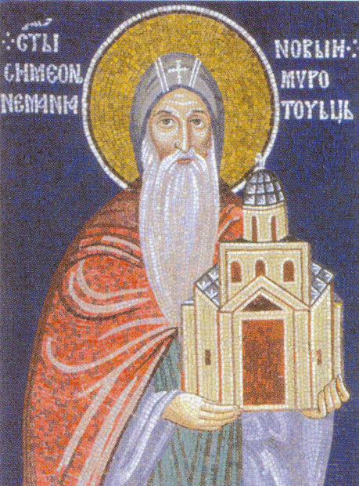
FOUNDER
1
GOOD NEWS
GABRIEL
VIRGIN MARY
GOSPEL
LADY DAY
ANNUNCIATION
2
3
4
The Studenica Monastery
is a 12th-century
Serbian Orthodox monastery,
located near Kraljevo
in central Serbia.
It was founded
by Serbian king
Stefan Nemanja
in 1190.
?
5
Notes:
3

Slide 4
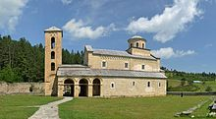
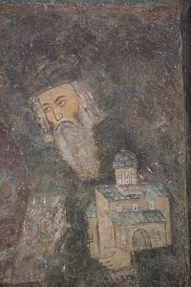
FOUNDER
1
LECHEROUS
LASCIVIOUS
DISSOLUTE
PRODIGAL
SINNING
UNCHASTE
2
3
4
The Sopoćani monastery
is a 13th century Serbian
Orthodox monastery,
located near the source of
Raška River, in the region
of Ras, the centre of
Serbian medieval state. It
was founded by
King Stefan Uroš I.
?
5
Notes:
4

Slide 5
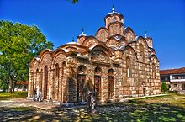
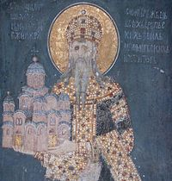
FOUNDER
INFINITE
SUPREME BEING
THE DEITY
DIVINITY
FATHER, SON AND THE HOLY SPIRIT
GOD
1
2
3
4
Gračanica monastery is
a 14th century Serbian
Orthodox monastery,
located in Kosovo.
It was founded by Serbian
King Stefan Milutin in 1321.
?
5
Notes:
5

Slide 6
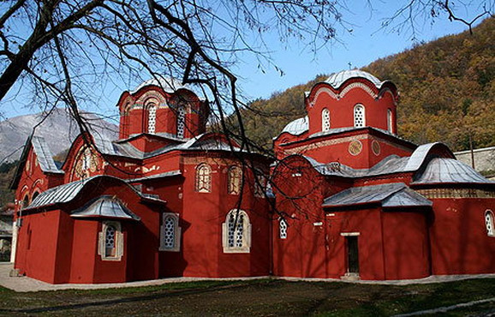
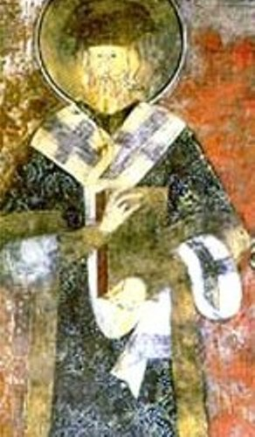
FOUNDER
THE TWELFTH DAY
THE MANIFESTATION OF OUR LORD
THE REVELATION OF GOD
THEOPHANY
THE BAPTISM OF CHRIST IN JORDAN
EPIPHANY
1
2
3
4
The Serbian Patriarchate
of Peć was an
autocephalous Serbian
Orthodox Partriarchate
that existed from 1346 to
1766 with seat in
Patriarchal Monastery
in Peć. It was founded by
Serbian Archbishop
Joanikije II.
?
5
Notes:
6

Slide 7
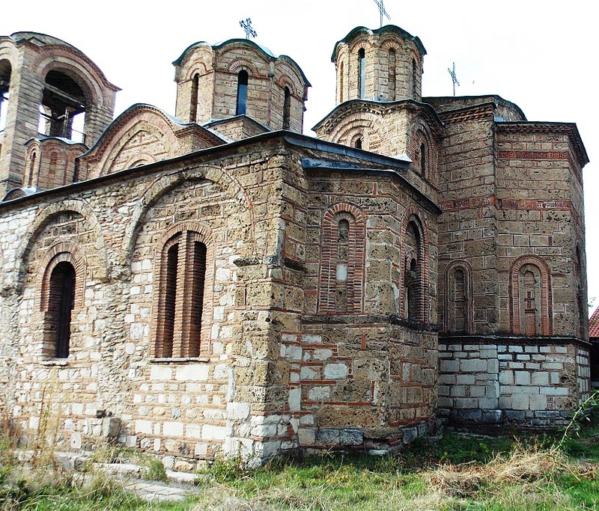
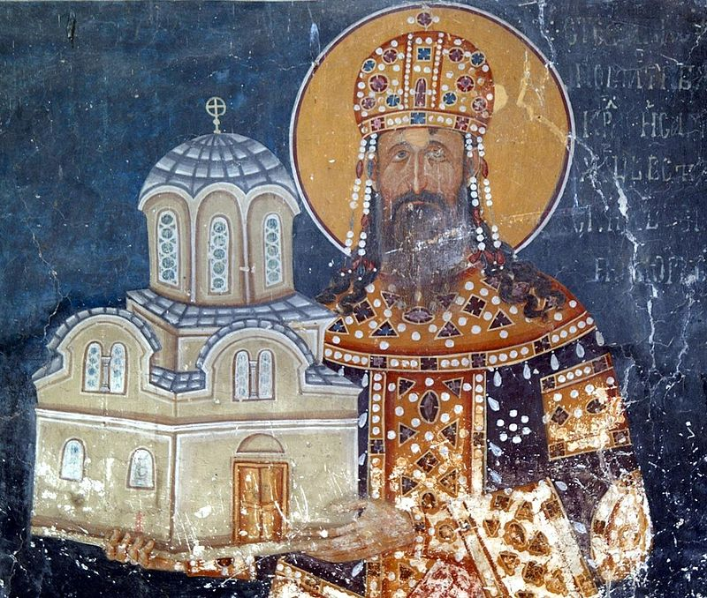
FOUNDER
1
THE VIRGIN
MARY
OUR LADY
THEOTOKOS
VIRGIN DEVOTED TO GOD
MOTHER OF GOD
2
3
4
Church of Our Lady
Of Ljeviš is a 14th
Century Sebian Orthodox
church, located in the
Town of Prizren in Kosovo
And Metohija. It was
Founded by Serbian King
Stefan Milutin.
?
5
Notes:
7

Slide 8
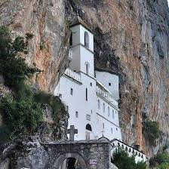
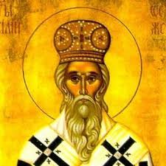
FOUNDER
1
FUNDAMENTAL
DOGMATIC
COMPARATIVE
MORAL
DIVINITY
THEOLOGY
2
3
4
The Monastery of Ostrog
is situated high up
in the large rock of
Ostroška Greda, near Nikšiić,
in Montenegro.
It is dedicated to Saint
Basil of Ostrog, who
was buried there. It’s one
of the most popular
Orthodox pigrimage
places.
?
5
Notes:
8

Slide 9
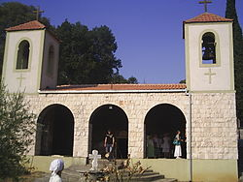
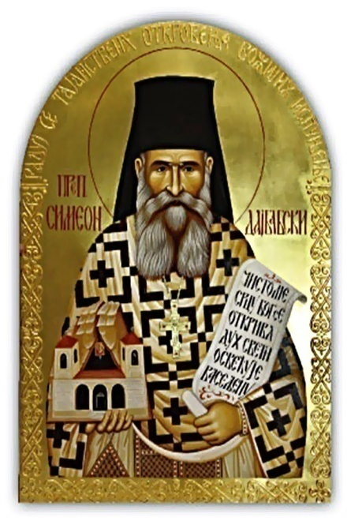
FOUNDER
WORSHIPPING OF GOD
CHURCH/ PUBLIC WORSHIP
SERVICE OF WORSHIP
DIVINE WORSHIP
MINISTERING
DIVINE SERVICE
1
2
3
4
Dajbabe Monastery is
located in a cave of Dajbabe
hill, in Podgorica,
Montenegro.
It was founded by Saint
Simeon of Dajbabe
In 1897.
?
5
Notes:
9

Slide 10
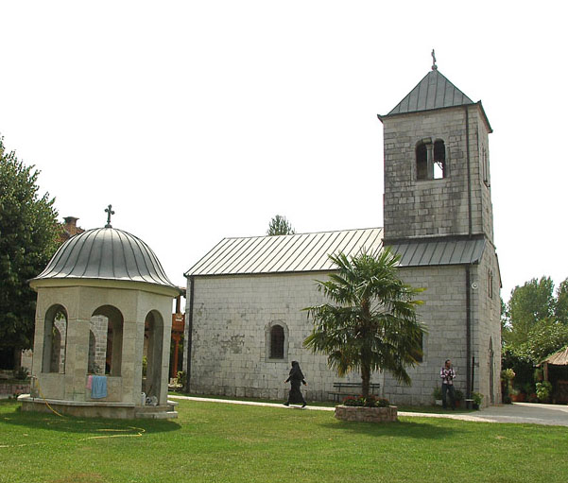
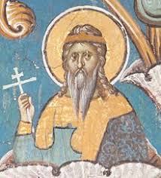
FOUNDER
THEANDROS
THEANTHROPOS
GOD-MAN
EMBODYING DEITY IN HUMAN FORM
OUR LORD
JESUS CHRIST
1
2
3
4
Ždrebaonik monastery is
Located in Sekulići, near
Danilovgrad, Montenegro.
It was founded by
Vukan Nemanjić
In the 13th century.
?
5
Notes:
10

Slide 11
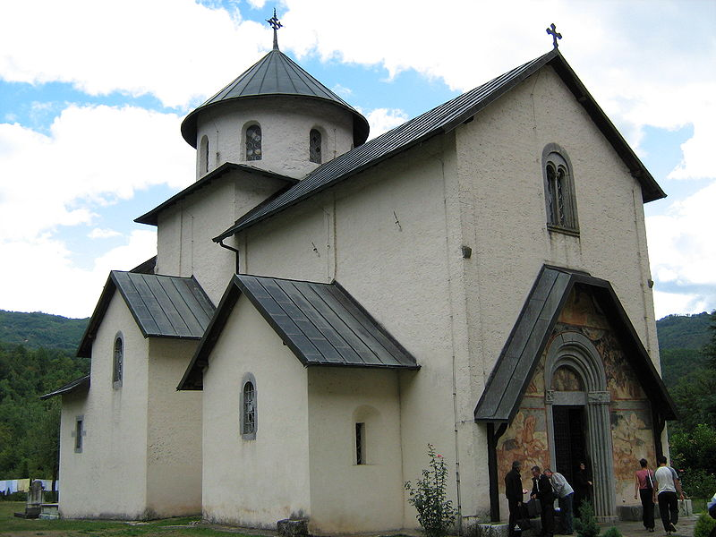
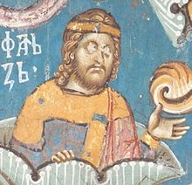
FOUNDER
1
RATIFICATION OF …
INTER
CIVIL
CHURCH
MATRIMONY
MARRIAGE
2
3
4
Morača monastery is
located in the valley of
Morača river in Kolasin,
Montenegro. It was
founded by Stefan
Vukanovic Nemanjić
In 1252.
?
5
Notes:
11

Slide 12
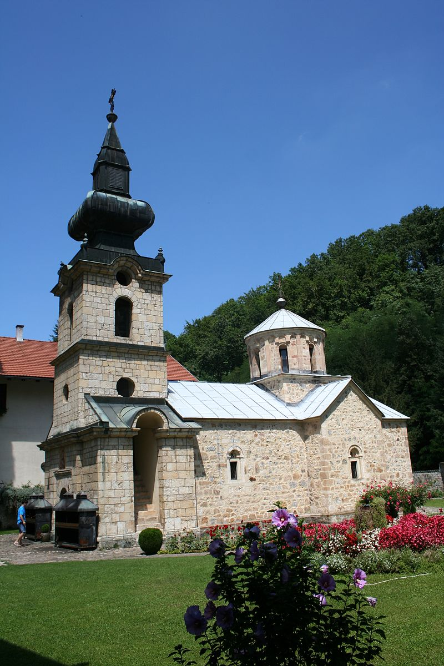
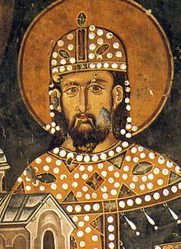
FOUNDER
1
LEADING IN
TEMPLE
INTRODUCTION
VIRGIN MARY
THE ENTRY OF MOTHER OF GOD INTO THE TEMPLE
PRESENTATION OF THE HOLY THEOTOKOS
2
3
4
Tronoša Monastery is
oocated between villages
Of Tršić and Tronoša, near
Loznica, Serbia.
It was found by King Stefan
Dragutin in 1317.
?
5
Notes:
12

Slide 13
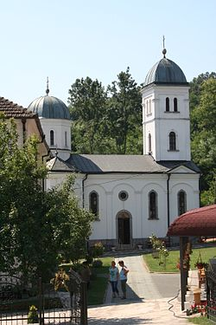
FOUNDER
1
LIFTING
RISING UP
HOLY THURSDAY
MOUNT
ASCEND
ASCENSION OF OUR LORD JESUS CHRIST
2
3
4
Petkovica Monastery is
located in Petkovica,
near Šabac, Serbia. It was
found by King
Stefan Dragutin in
The 13th century.
?
5
Notes:
13

Slide 14
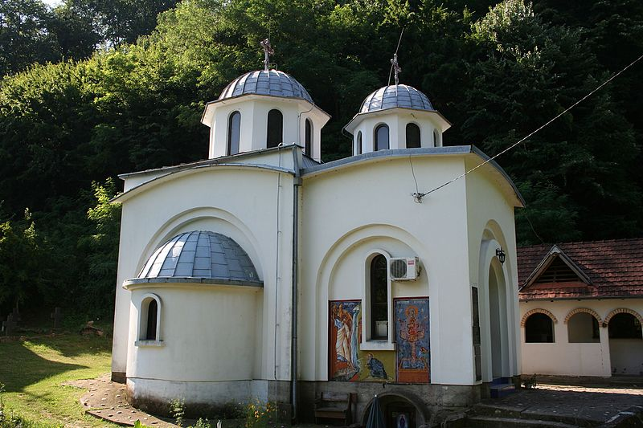
FOUNDER
REVIVE
ARISE
RISE AGAIN
RESTORE TO LIFE
RISE FROM THE DEAD
RESURRECT
1
2
3
4
Radovašnica Monastery
is in Radovašnica,
near Šabac, Serbia. It was
founded by Kind Stefan
Dragutin in the 13th
century.
?
5
Notes:
14

Slide 15
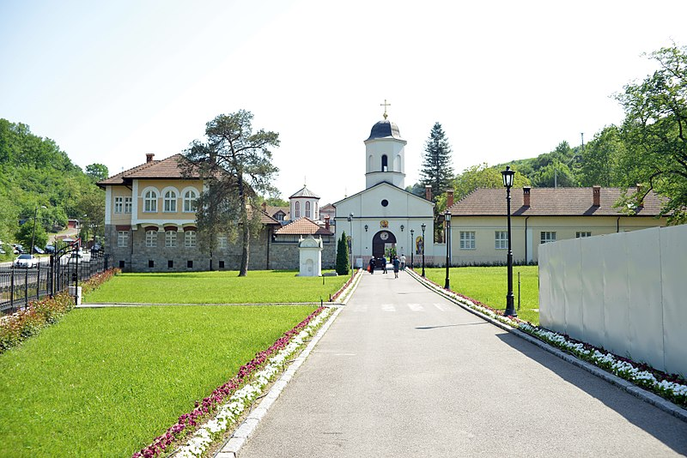
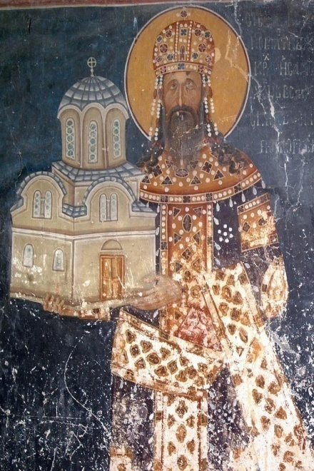
FOUNDER
1
DEEP-SEATED
TRUST
BELIEF
THE ORTHODOX
RELIGION
FAITH
2
3
4
Rakovica Monastery is
located in Belgrade
suburb of Rakovica.
It was founded by
Serbian Kings
Dragutin and Milutin
In the 14th century.
?
5
Notes:
15

Slide 16
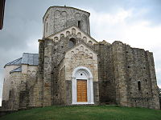
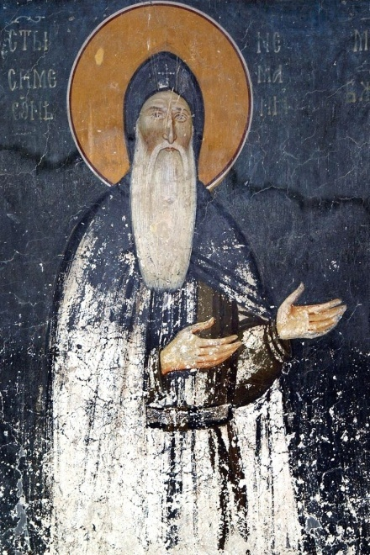
FOUNDER
1
CREED
PROFESSION OF FAITH
CONFESSION
FAITH
RELIGION
DENOMINATION
2
3
4
Đurđevi stupovi
monastery is located
in the vicinity of
today’s town of Novi
Pazar, in the Raška
region of Serbia.
It was founded by
by Grand Prince Stefan
Nemanja in the 12th
century.
?
5
Notes:
16

Slide 17
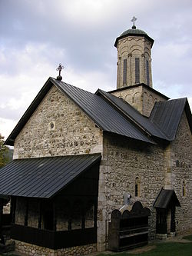
FOUNDER
VENIAL
INVOLUNTARY
ORDINARY
ORIGINAL
DEADLY
SIN
1
2
3
4
The Liplje Monastery is
located in the Municipality
of Teslić, in Northern
Republika Srpska, Bosnia
and Herzegovina. It was
founded by Stefan
Dragutin in the 13th
century.
?
5
Notes:
17

Slide 18
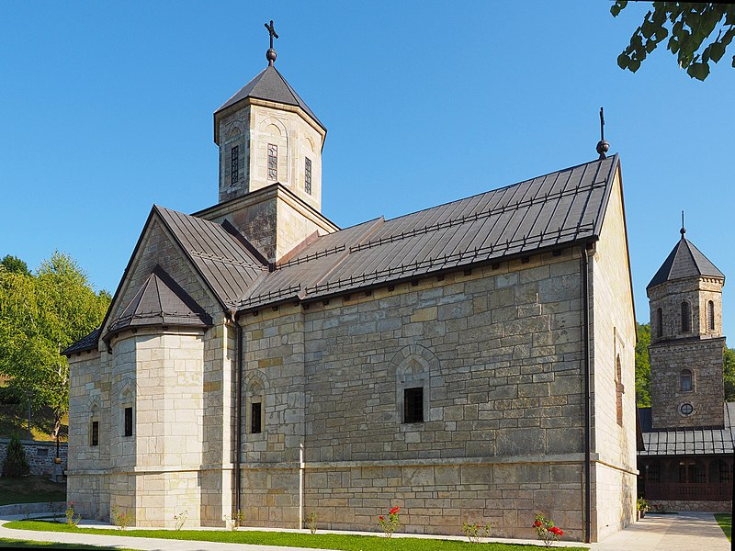
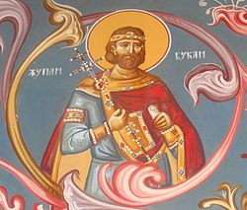
FOUNDER
1
CONCESSION
DONATION
TALENT
…OF GOD
PRESENT
GIFT
2
3
4
Moštanica Monastery is
located in Kozarska
Dubica, Republika Srpska,
Bosnia and
Herzegovina. It was
founded by Grand Prince
Vukan in the12th century.
?
5
Notes:
18

Slide 19
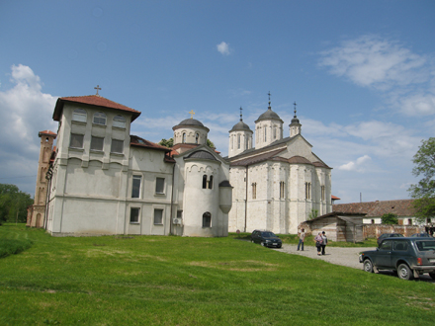
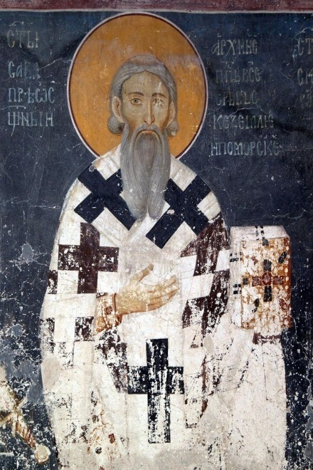
FOUNDER
1
ALMS
CHARITY
WORK
ACT
GOOD
DEED
2
3
4
The Kovilj Monastery is
located in the Bačka
region, in the northern
Serbian province of
Vojvodina. It was
founded by the first
Serbian archbishop
Saint Sava in the 13th
Century.
?
5
Notes:
19

Slide 20
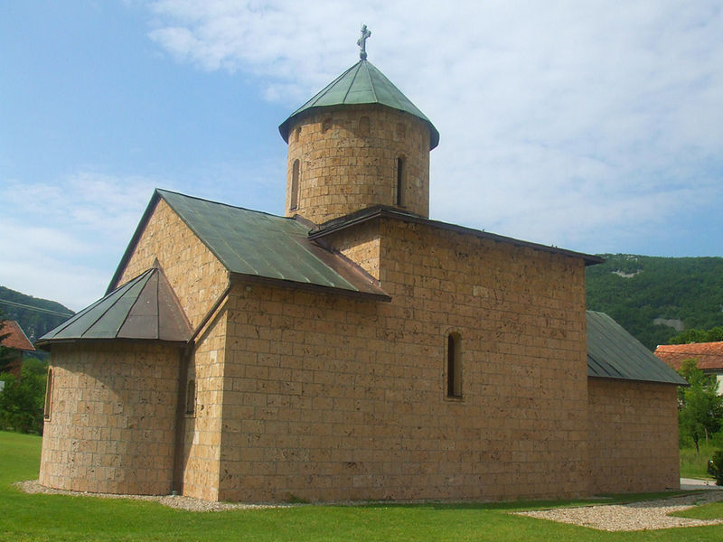
FOUNDER
1
PARACLETE
THE COMFORTER
HOLY GHOST
GOD
FATHER, SON AND …
THE HOLY SPIRIT
2
3
4
The Rmanj Monastery
is located in Martin Brod,
In north-western Bosnia
and Herzegovina. It was
founded by Stefan
Dragutin
in the 14th century.
?
5
Notes:
20

Slide 21
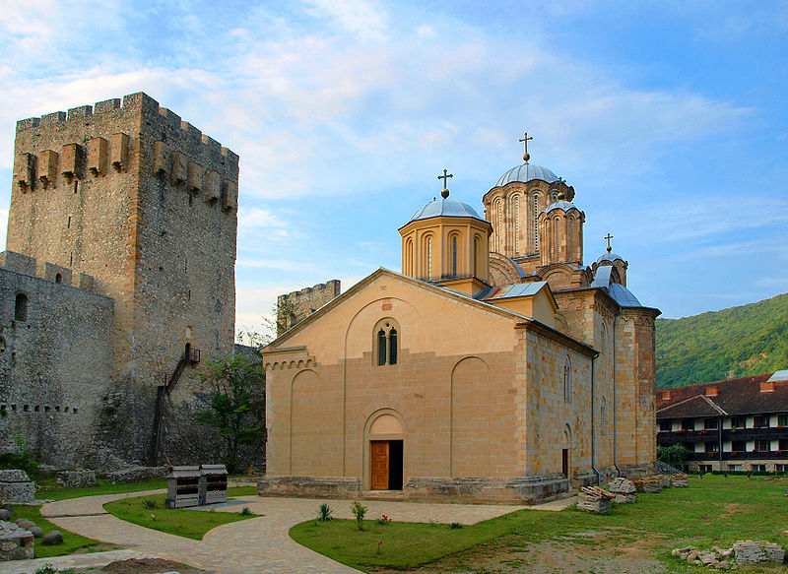
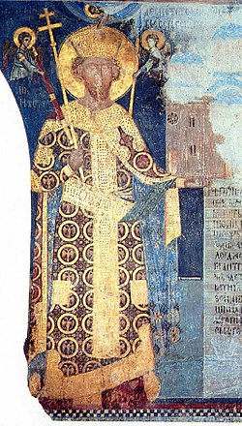
FOUNDER
1
BREAK ONE’S …
TRANSMIGRATION OF …
PRAY FOR THE REPOSE OF ONE’S …
RESIGN ONE’S … INTO THE HANDS OF GOD
GOD REST HIS …
SOUL
2
3
4
Manasija or Resava
is located near
Despotovac, Serbia. It
was founded by
Despot Stefan
Lazarević in
the 15th century.
?
5
Notes:
21

Slide 22
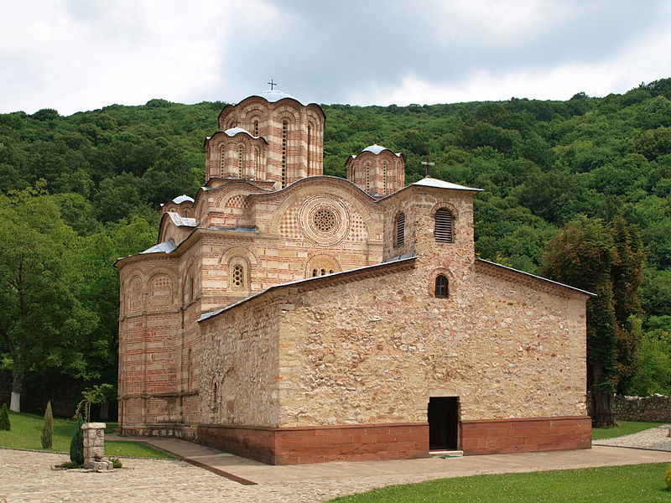
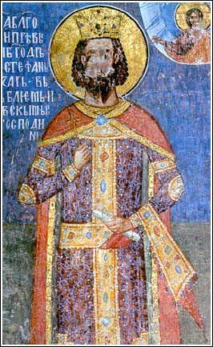
FOUNDER
… CREATING
… GIVING
ECCLESIASTIC
EVERLASTING
AFTER
LIFE
1
2
3
4
Ravanica is located near
Ćuprija, Serbia. It was
founded by
by Prince Lazar
of Serbia in the 14th century.
?
5
Notes:
22

Slide 23
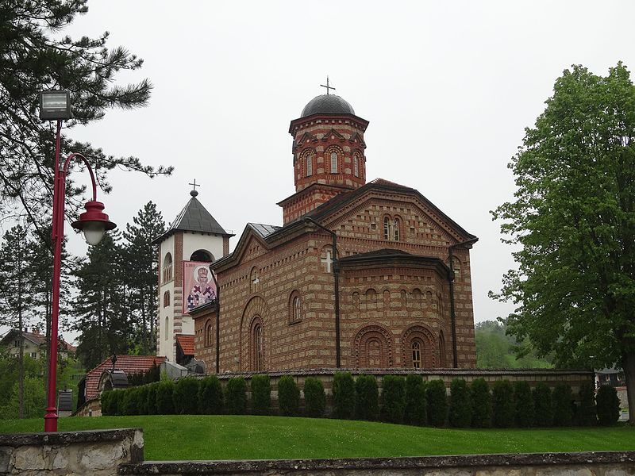
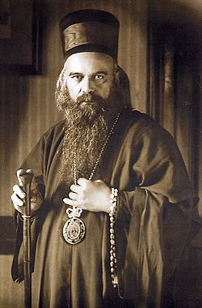
FOUNDER
MISTAKE
ERROR
BE UNDER A …
LEAD INTO …
LEAD OUT OF …
DELUSION
1
2
3
4
Lelić Monastery is
located in Lelic, near
Valjevo, Serbia. It was
founded by Saint
Nicolai of Ochrid and Zica
in 1996.
?
5
Notes:
23

Slide 24
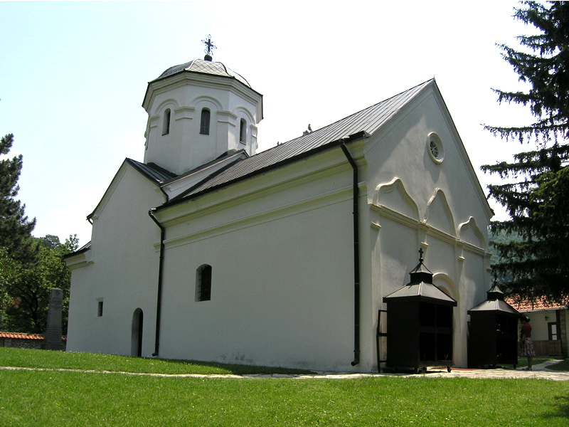
FOUNDER
1
GREATER
MAJOR
LESSER
MINOR
ANATHEMA
EXCOMMUNTICATION
2
3
4
The Ćelije Monastery is
located by the Gradac
River, near Valjevo.
It was founded by
Stefan Dragutin in
the 13th century.
?
5
Notes:
24

Slide 25
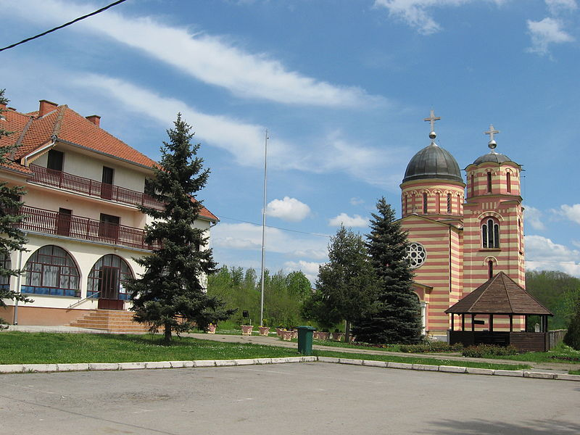
FOUNDER
PENITENCE
REPENTANCE
HEARTFUL
THE HOLY
GO TO …
CONFESSION
1
2
3
4
Monastery Grabovac is
located in Grabovac,
near Obrenovac.
It was founded by kings
Milutin and Dragutin
in 1282.
?
5
Notes:
25

Slide 26
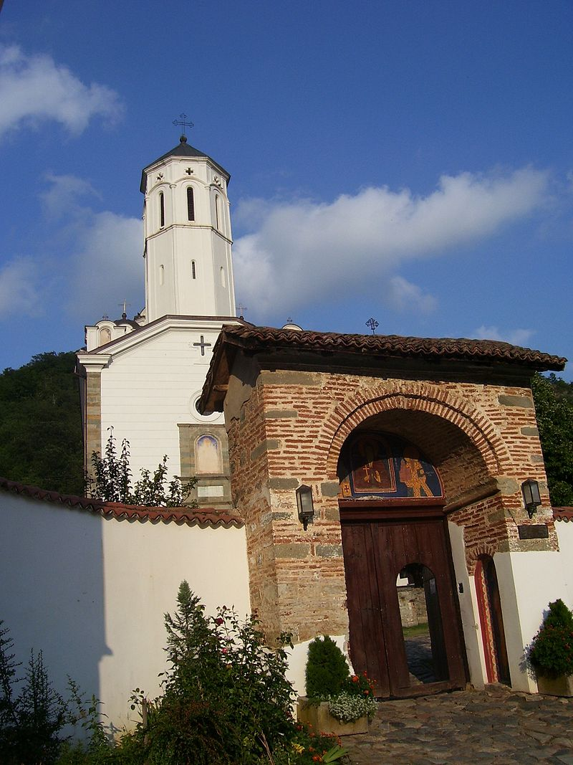
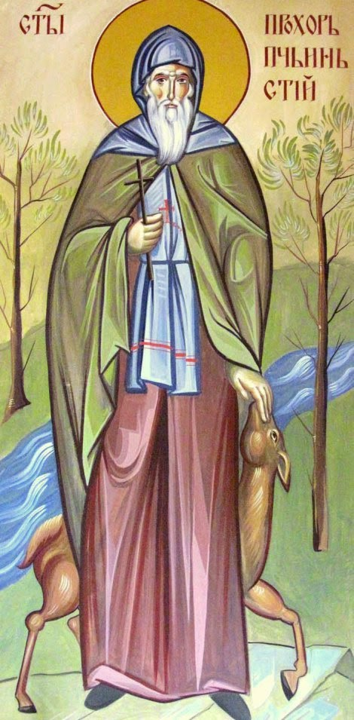
FOUNDER
1
GOSPEL
… OF ST. MATTHEW
… OF ST. MARK
… OF ST. LUKE
… OF ST. JOHN
EVANGEL
2
3
4
The Monastery of
venerable Prohor of Pčinja
Is located in Klenike,
near Vranje.
It was founded by
Saint Prohor of Pčinja
in the 11th century.
?
5
Notes:
26

Slide 27
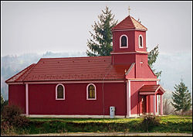
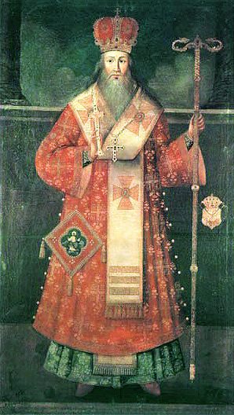
FOUNDER
1
INTERCESSION
PETITION
… OF SILENCE
… OF THE MIND
… OF THE HEART
PRAYER
2
3
4
Gorica Monastery is
located in Donji
Budacki, Kordun,
Croatia. It was founded by
Arsenije III Carnojević, the
Archbishop of Pec and
Serbian Patriarch in the 17th
Century.
?
5
Notes:
27

Slide 28
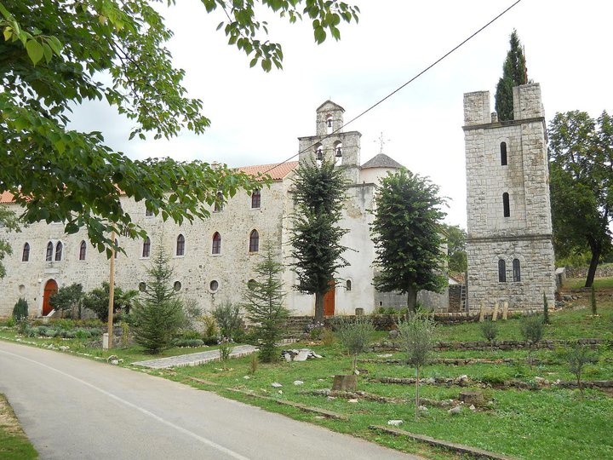
FOUNDER
1
VAIN
FALSE
LIVE ON …
FEED ON …
GIVE …
HOPE
2
3
4
Krupa Monastery is the
oldest Orthodox
monastery in Croatia. It is
located between the towns
of Obrovac and Knin. It was
founded by Stefan Uros II
Milutin in 1317.
?
5
Notes:
28

Slide 29
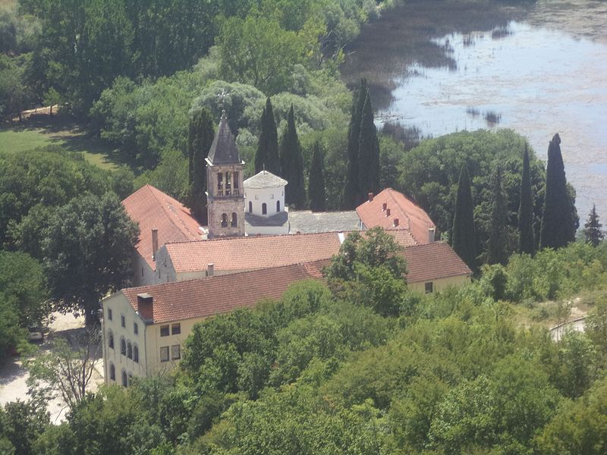
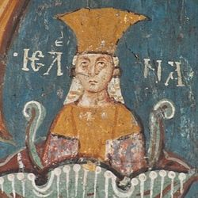
FOUNDER
1
THE SON OF …
DOOM
RUIN
DESTRUCTION
DEATH
PERDITION
2
3
4
Krka Monastery is
located near the river Krka,
in central Dalmatia,
Croatia. It was founded by
Princess Jelena Nemanjić
Šubić, half-sister of the
Serbian emperor Dusan
in the 14th century.
?
5
Notes:
29

Slide 30
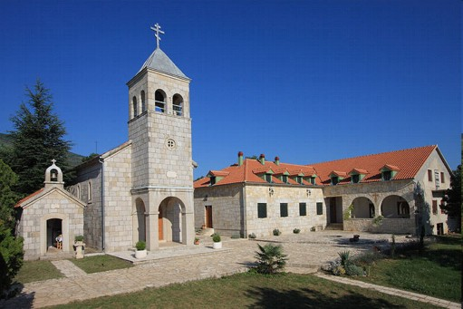

FOUNDER
1
ASCETIC ACTION
FEAT
ACHIEVE AN …
HEROIC DEED
GREAT DEED
EXPLOIT
2
3
4
Monastery Dragović is
located near Vrlika, Croatia.
It was founded by
Bosnian king Tvrtko I
Kotromanić in 1395.
?
5
Notes:
30

Slide 31

FOUNDER
1
CONCUPISCENCE
AVIDITY
GREED
LUST
… OF THE FLESH
DESIRE
2
3
4
Žica Monastery is located
near Kraljevo, Serbia.
It was founded by Stefan
Nemanja in the12th century.
?
5
Notes:
31

Slide 32


FOUNDER
1
VENERATION
DEVOTION
RESPECT
… FOR THE SAINTS
… OF THE VIRGIN OUR LADY
REVERENCE
2
3
4
Gradac Monastery is
located in Golija tourist
Region, near the tourist
centre Kopaonik, Serbia.
It was founded by
Queen Helen of Anjou
in the 13th century.
?
5
Notes:
32

Slide 33

FOUNDER
1
… IN HEAVEN
… ON EARTH
... MILITANT
... TRIUMPHANT
ORTHODOX
CHURCH
2
3
4
The Rača Monastery is
located near Bajina
Bašta, Serbia.
It was founded by
Stefan Dragutin in the 13th
century.
?
5
Notes:
33

Slide 34

FOUNDER
1
EPISCOPAL
… OF BREAD
… OF WINE
… OF BUILDING
CONSECRATED GIFTS
CONSECRATION
2
3
4
Tvrdoš Monastery is
located near the town
of Trebinje, Republika
Srpska, Bosnia and
Herzegovina.
It was found by Stefan
Uros II Milutin
in the 13th century.
?
5
Notes:
34

Slide 35

FOUNDER
DENOMINATION
FAITH
APOSTLES’
ATHANASIAN
NICENE-CONSTANTINOPOLITAN
CREED
1
2
3
4
The Zavala Monastery is
located in Zavala, near
Trebinje. Republika
Srpska, Bosnia and
Herzegovina.
It was founded by Stefan
Uros II Milutin
in the 13th century.
?
5
Notes:
35

Slide 36

FOUNDER
1
ARMS OF THE …
MAKE THE SIGN OF THE…
CRUCIFORM
CRUCIFY
THE CRUCIFIXION
CROSS
2
3
4
The Ozren Monastery is
located near Petrovo,
in northern Republika
Srpska, Bosnia and
Herzegovina.
It was founded by
Stefan Dragutin.
?
5
Notes:
36

Slide 37


FOUNDER
…OF FERVENT SUPPLICATION
… FOR THE CATECHUMENS
SUPPLIANT
GREAT
LITTLE
ECTENE
1
2
3
4
The Tavna Monastery is
located near Bijeljina,
Republika Srpska, Bosnia
and Herzegovina.
It was founded by King
Stefan Dragutin’s sons
Vladislav and Uros in
the 14th century.
?
5
Notes:
37

Slide 38


FOUNDER
1
OBSERVE THE … DAYS
THE GREAT (EASTER)…, LENT
THE … OF THE APOSTLES
THE DORMITION …
THE CHRISTMAS …
FAST
2
3
4
Ljubostinja is located
near Trstenik.
It was founded by princess
Milica Hrebeljanović
in the 14th century.
?
5
Notes:
38

Slide 39

FOUNDER
1
BASIL THE GREAT
GREGORY THE THEOLOGIAN
JOHN CHRYSOSTOM
HIERARCHY
HIERARCH
THE THREE GREAT HIERARCHS
2
3
4
The Crna Reka Monastery
is located in Ribariće,
in southwestern Serbia.
It was founded by
Princess Milica
Hrebeljanović in the
14th century.
?
5
Notes:
39

Slide 40

FOUNDER
1
... OF HOLIES
… ORDERS
… CROSS DAY
... WATER
... LAND
HOLY
2
3
4
The Vozuca Monastery
is located in Vozuća,
Bosnia and Herzegovina.
It was founded by
Stefan Dragutin in the 14th
century.
?
5
Notes:
40

Slide 41

FOUNDER
1
… UNCTION
... ICON STAND
… MATRIMONY
… WEEK
… GOD
HOLY
2
3
4
The Monastery of
Dormition of The Holy
Theotokos is located
in Čajniče, Bosnia and
Herzegovina.
It was founded by
Stefan Uros II Milutin
in the 14th century.
?
5
Notes:
41

